Slide 1
RFM Customer Lifetime Value Analysis
Unlocking Customer Insights for Better Business Decisions
PRESENT BY: BHEKI MOGOLA
DATE PREPARED: 13/07/2025

Slide 2
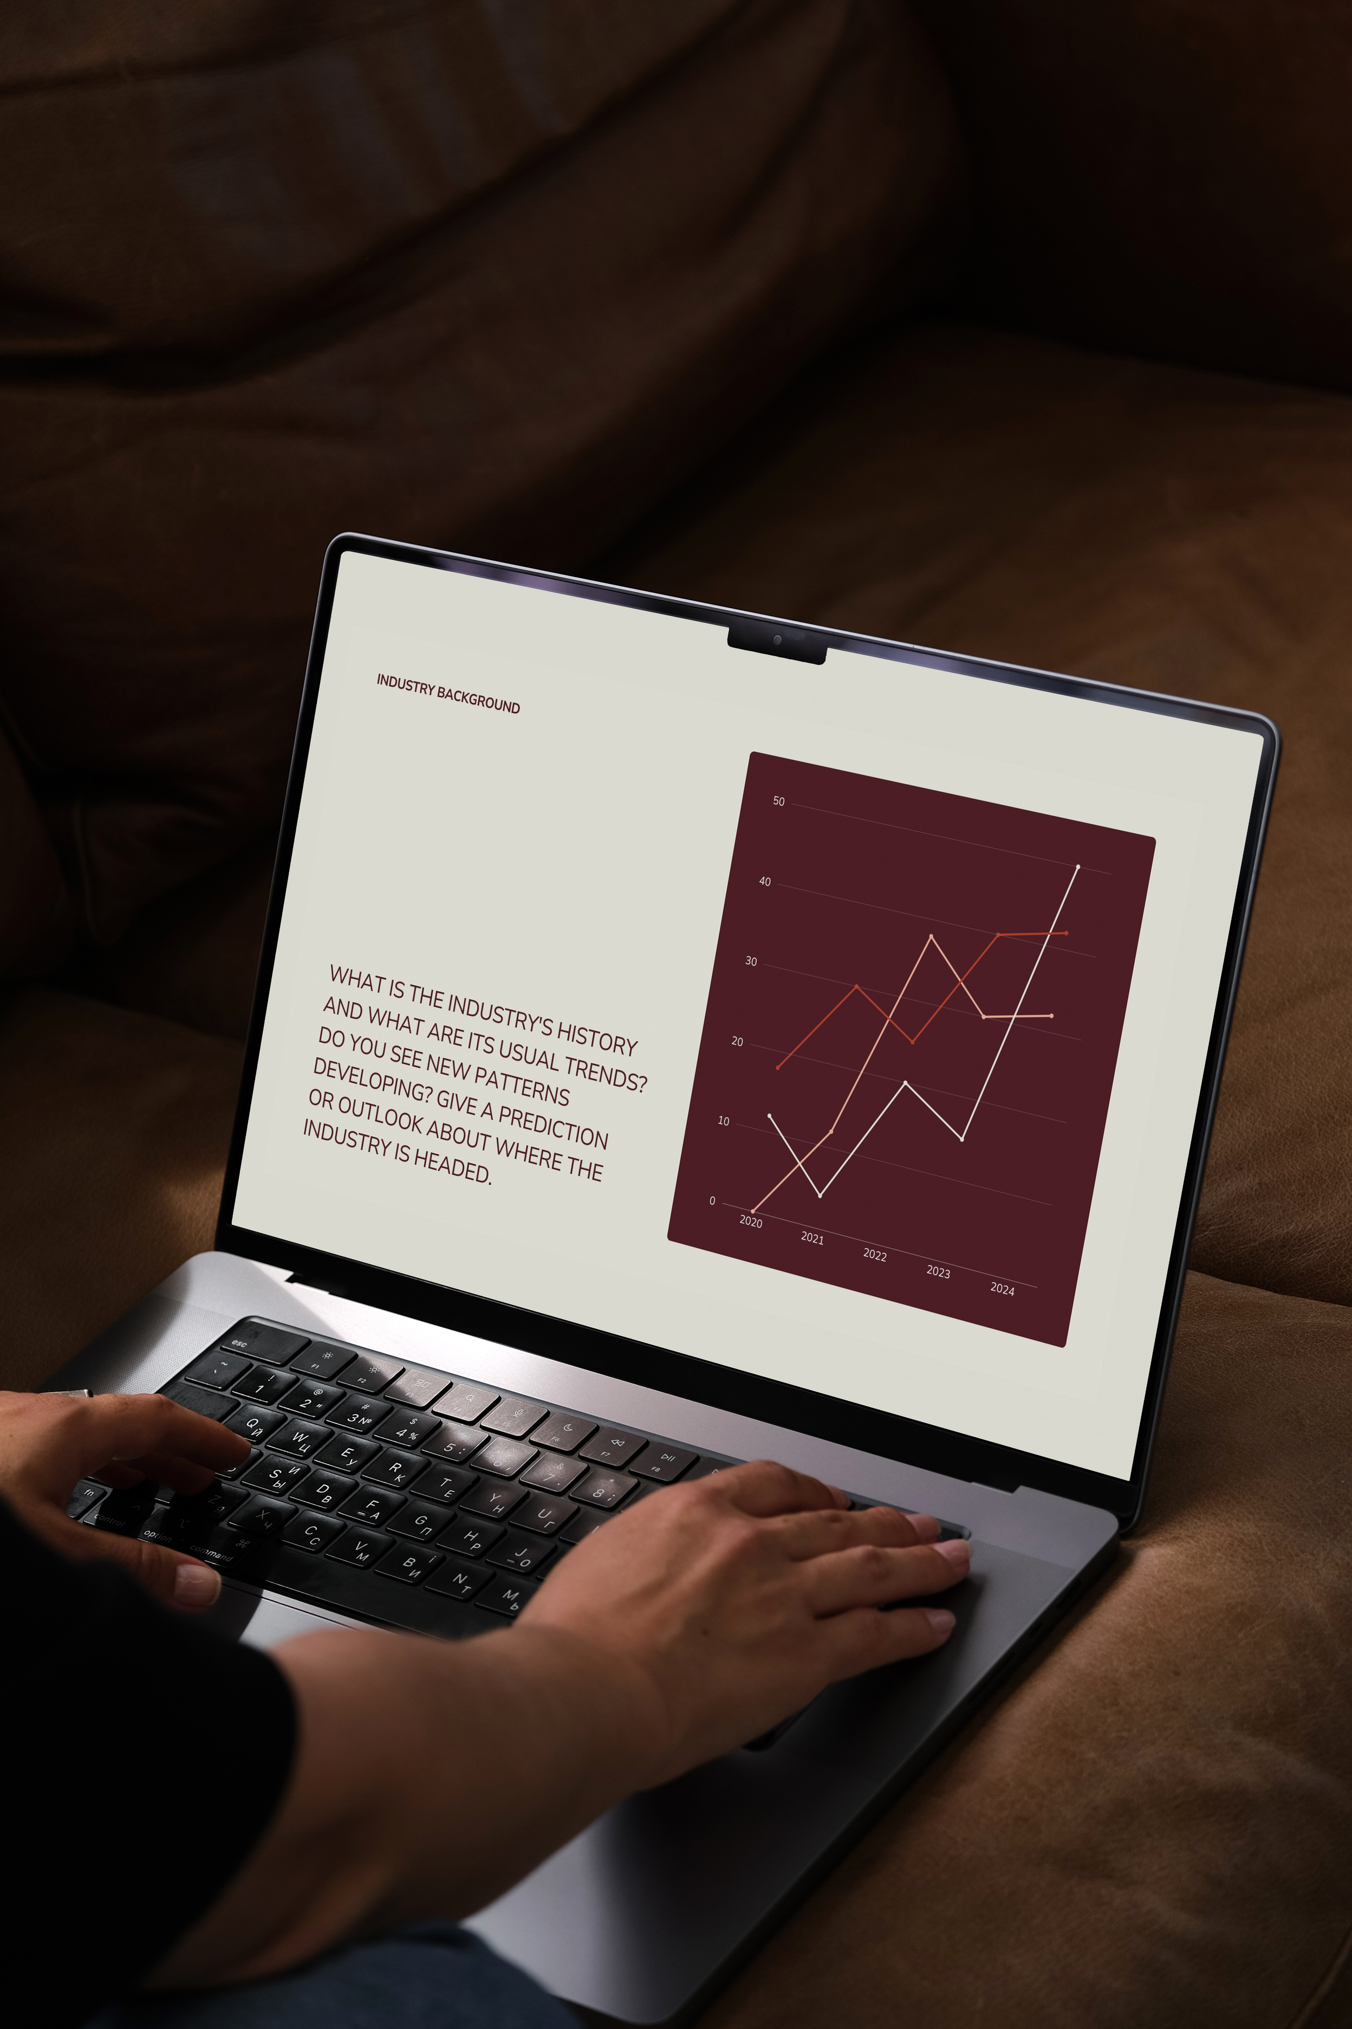
Project Overview
OBJECTIVE:
Segment customers based on purchasing behavior.
Deliver insights that support retention and marketing strategies.
Dataset:
Online Retail Dataset (UCI Repository)
500,000+ transactions

Slide 3
Why RFM Analysis?
HELPS BUSINESSES:
1
IDENTIFY LOYAL, HIGH-VALUE CUSTOMERS.
2
DISCOVER AT-RISK AND LOST CUSTOMERS.
3
TAILOR MARKETING CAMPAIGNS FOR EACH GROUP.
METRICS USED:
1
RECENCY
2
FREQUENCY
3
MONETARY

Slide 4
Tools & Technologies
PYTHON:
:Data cleaning and analysis
SQLITE:
SQL transformation and metric computation
EXCEL:
Initial cleaning
TABLEAU PUBLIC:
Dashboard visualization

Slide 5
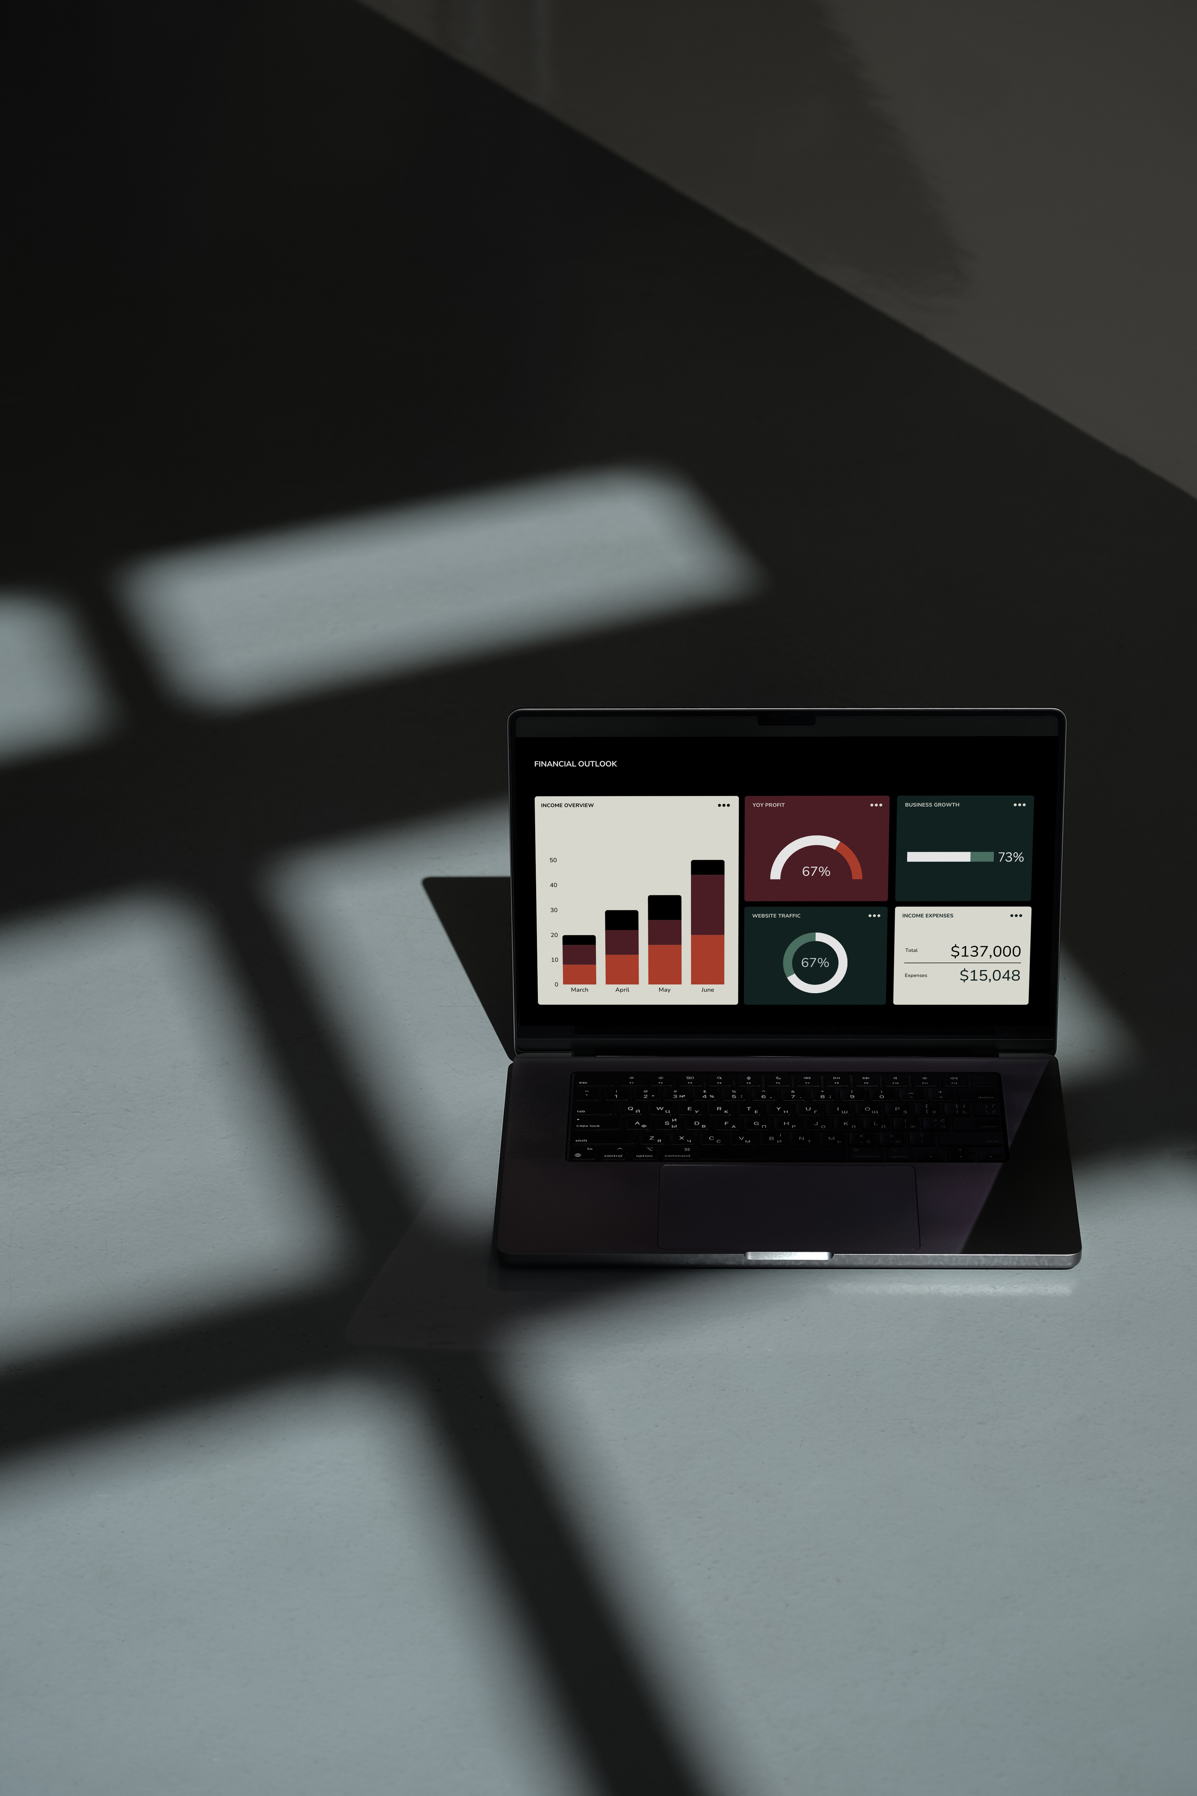
Data Cleaning & Preparation
REMOVED NULLS, FIXED DELIMITERS
Reformatted dates
Ensured appropriate data types
Exported to SQLite

Slide 6
RFM Score & Segmentation
Calculated R, F, M scores (scale 1-4)
Created combined RFM_Score
Segmented into:
Champions
Loyal Customers
At Risk
Lost
Need More Attention

Slide 7
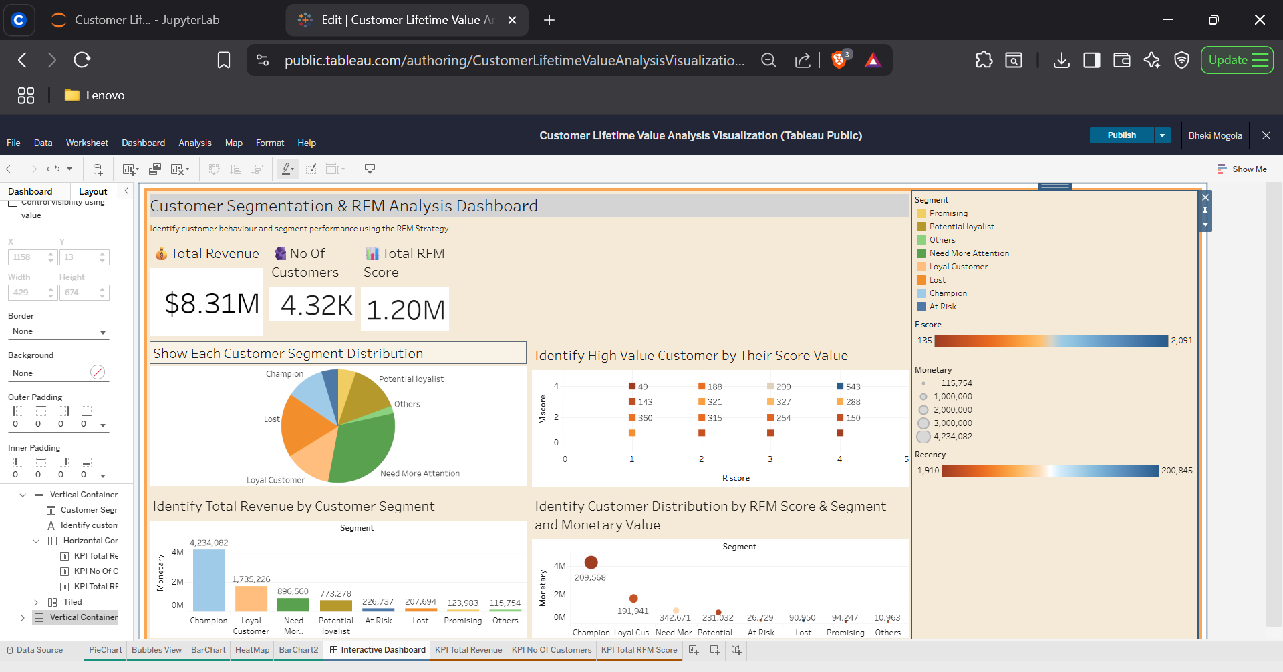
Tableau Dashboard Overview

Slide 8
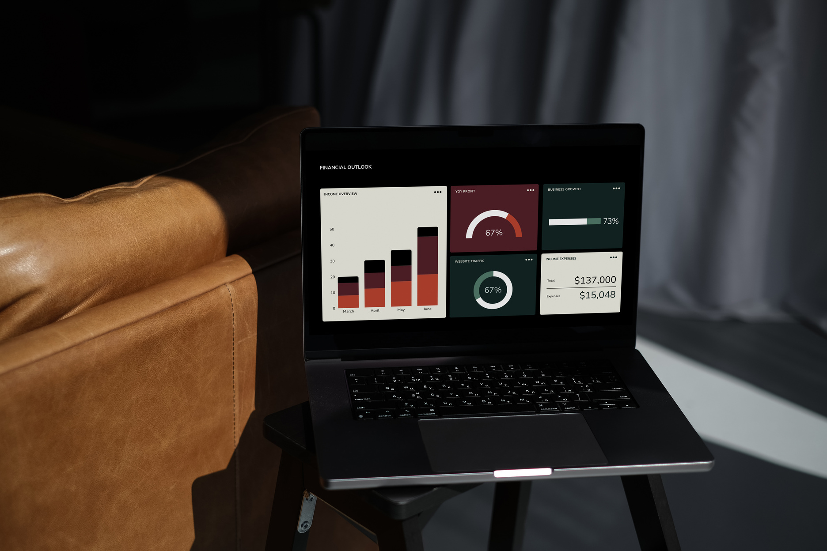

Key Insights
CHAMPIONS = HIGHEST REVENUE
At Risk & Lost = urgent focus
Loyal = upsell opportunity
"Need More Attention" = growth potential

Slide 9
Recommendations
BUILD LOYALTY PROGRAMS FOR CHAMPIONS
Launch win-back campaigns for Lost
Personalized campaigns for "Need More Attention"
Analyze segments monthly

Slide 10
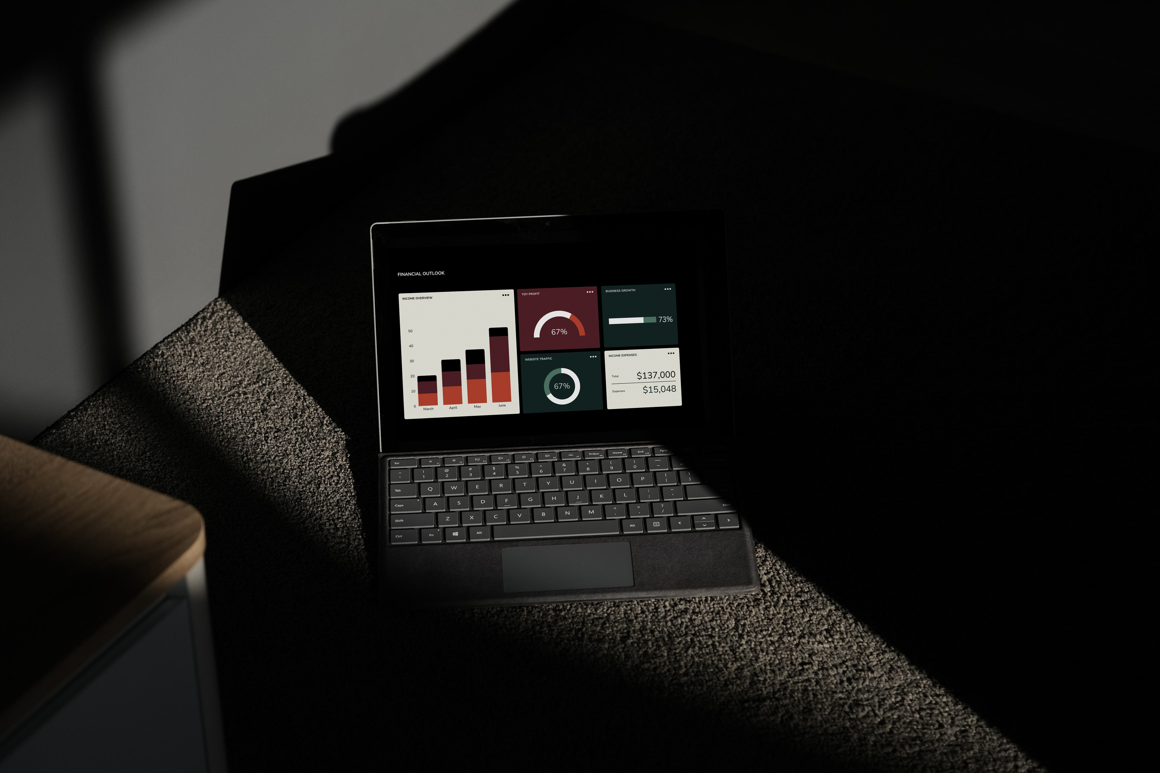
Value to Stakeholders
DATA-DRIVEN CUSTOMER STRATEGY
Increased marketing ROI
Improved retention and revenue

Slide 11
Next Steps
INCORPORATE CLTV PREDICTION
Add churn analysis
Automate RFM scoring pipeline

Slide 12
Thank You
QUESTIONS & DISCUSSION?

